Slide 1
Design Review
Emergency TA Availability
Ruiwen Li
Zheqing Li
Stephen Chuang

Slide 2
Introduction
Lack a way for TAs and professor in charge communicate efficiently
Provide a list of available TAs

Slide 3
Requirements
Functional: login, schedule, database
Non-functional: security, reliability, performance
Constraints: web-based, Linux OS, Chrome, Firefox

Slide 4






Technology Used

Slide 5
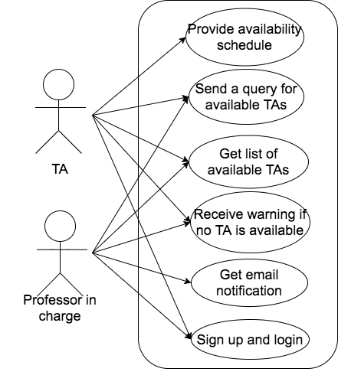
Use Case

Slide 6
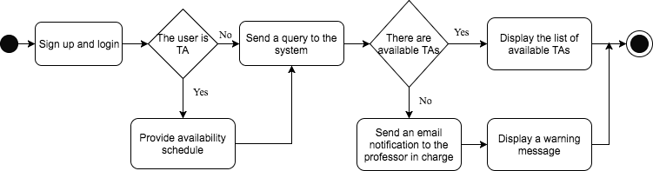
Activity Diagram

Slide 7
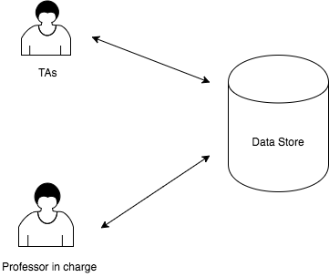
Architecture

Slide 8
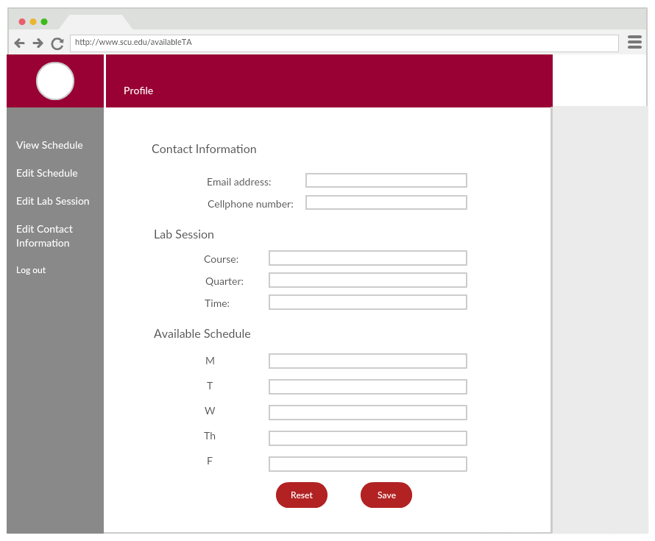
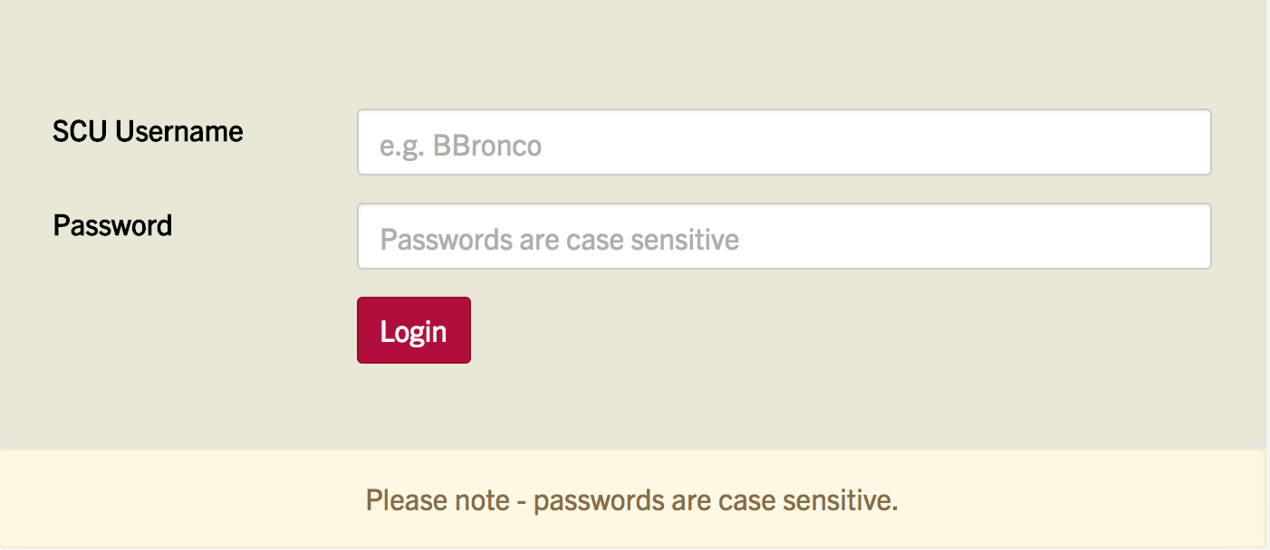
Conceptual Model

Slide 9
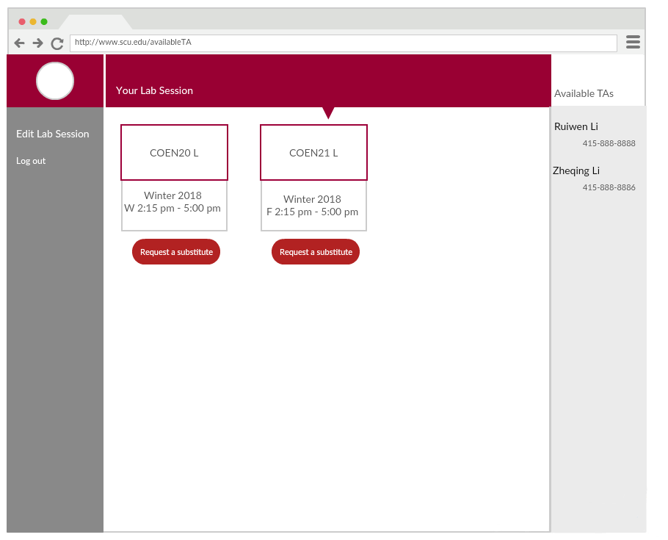
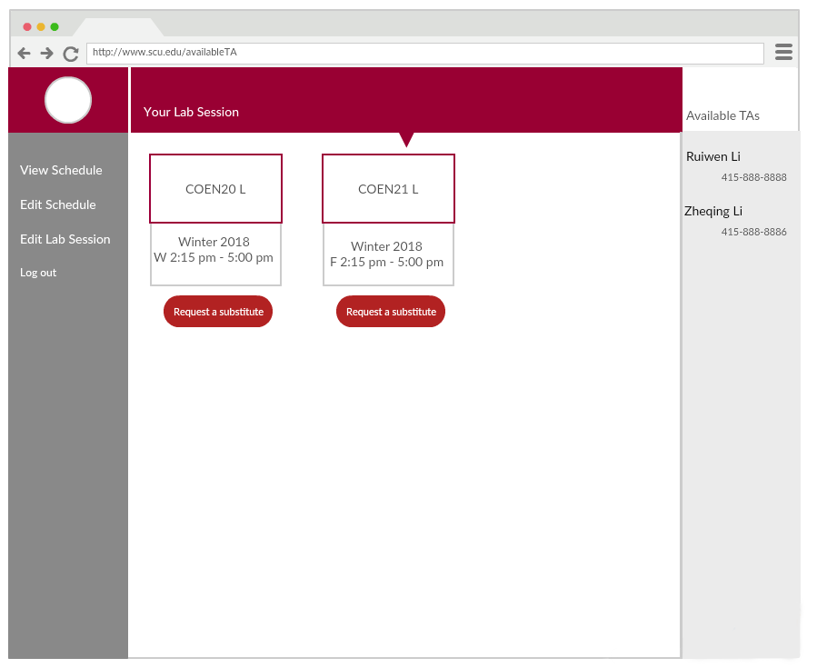
Conceptual Model

Slide 10
Risk Analysis
Risk | Consequences | Probability | Severity | Impact | Mitigation Strategies
Teammate gets sick, schedule conflicts | Could not finish the project on time | 0.3 | 10 | 3 | Shift our tasks if necessary
Spend long time building the system | Could not follow the timeline | 0.2 | 9 | 1.8 | Find help outside of the class, and spend more time
Operating system not working, or some tools not supported on browser | Application not functional | 0.1 | 10 | 1 | Built reliable secure, sufficient, functional system

Slide 11
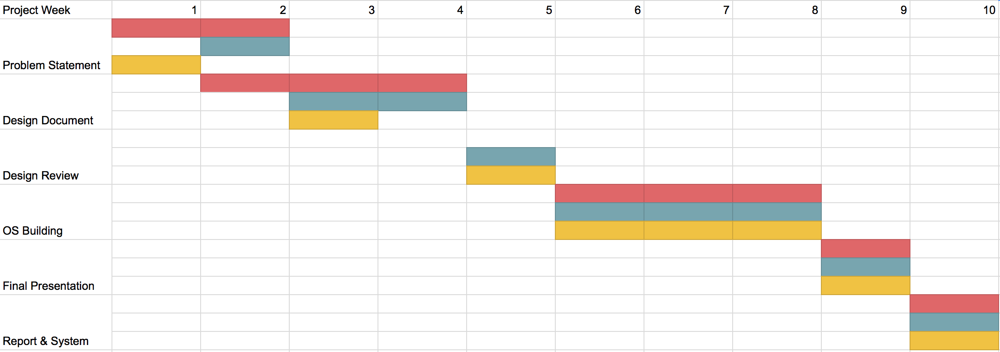
Development Timeline
Louise
Zheqing
Stephen

Slide 12
Questions?

Slide 13
Thank you!

